Slide 1
Computational Biology
Comparison between Experimental and theoretical
Prof. Dr. Ibrahim Al-Awadi
Eng. Ghada Samir

Slide 2
Introduction
Comparison between Experimental and theoretical
Link access to data:
https://www.ebi.ac.uk/pride/archive/projects/PXD012803

Slide 3
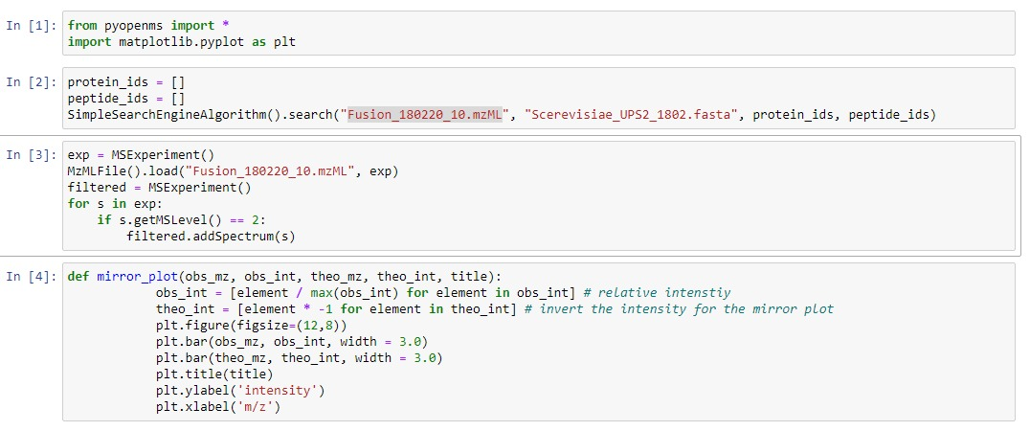
Code

Slide 4
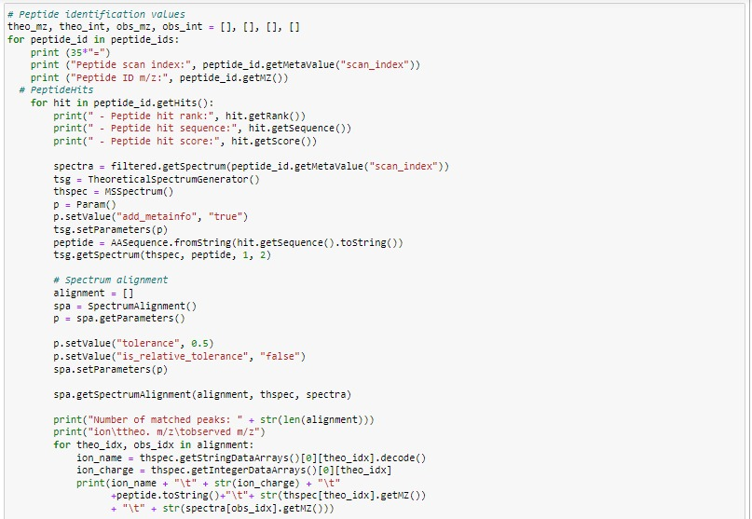
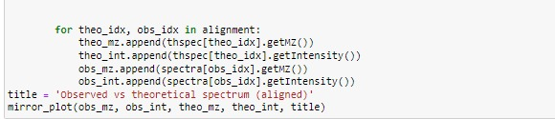
Code

Slide 5
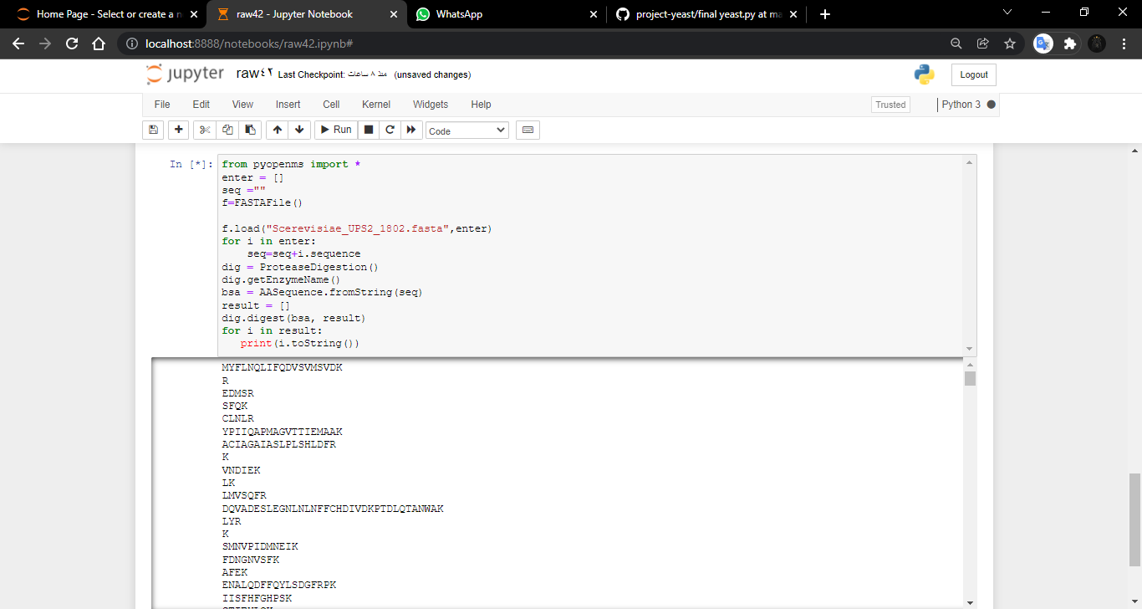
MYFLNQLIFQDVSVMSVDK
R
EDMSR
SFQK
CLNLR
YPIIQAPMAGVTTIEMAAK
ACIAGAIASLPLSHLDFR
K
VNDIEK
LK
LMVSQFR
DQVADESLEGNLNLNFFCHDIVDKPTDLQTANWAK
LYR
K
SMNVPIDMNEIK
FDNGNVSFK
AFEK
ENALQDFFQYLSDGFRPK
IISFHFGHPSK
STIEYLQK
.
.
.
Yeast Peptides
After Digestion with Trypsin

Slide 6
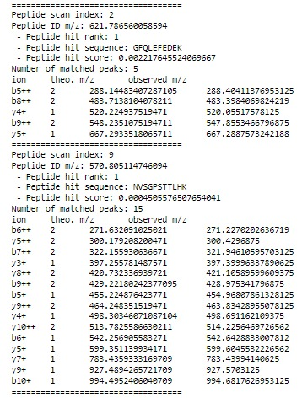
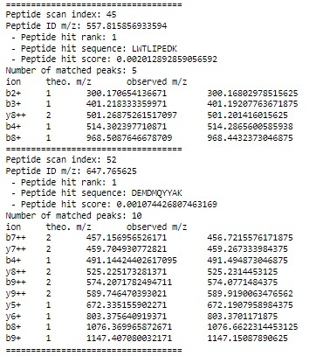
File Fusion_180220_07.mzML (Output)

Slide 7
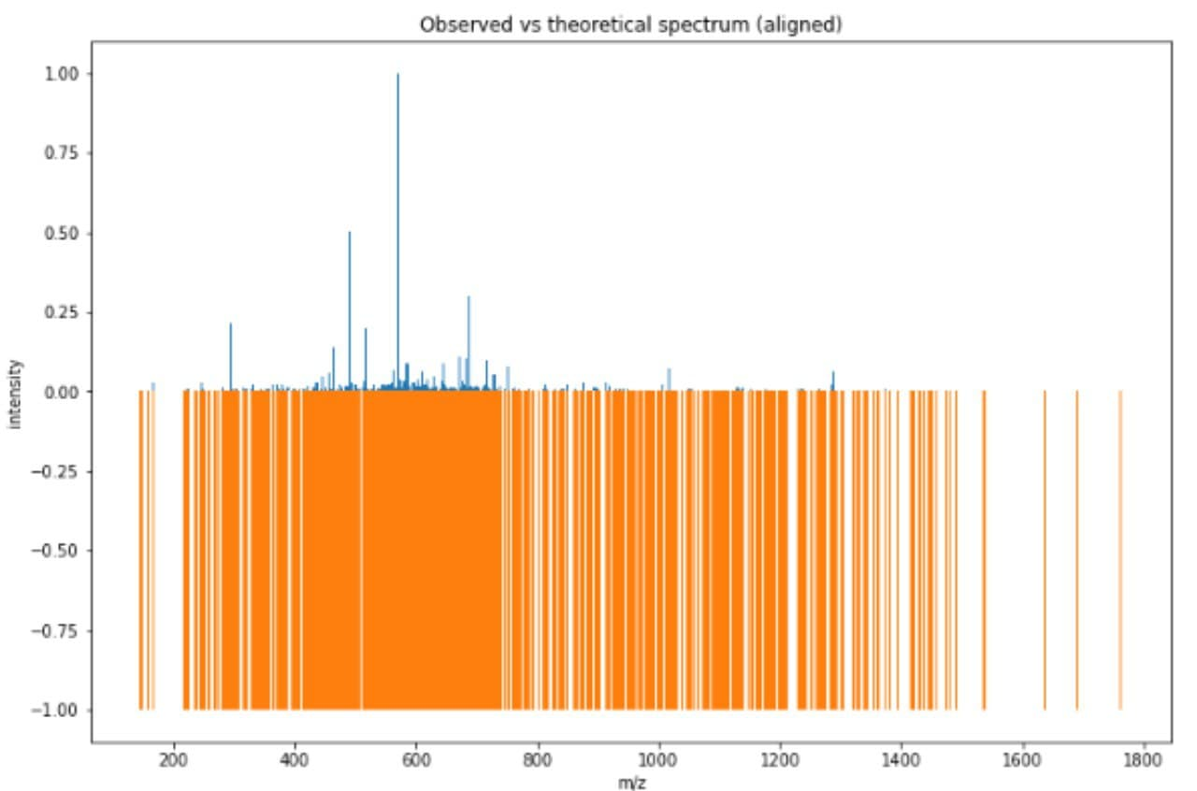

Slide 8
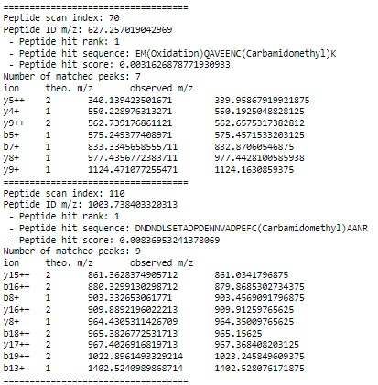
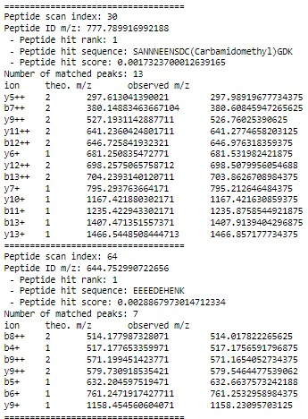
Fusion_180220_08.mzML)Output)

Slide 9
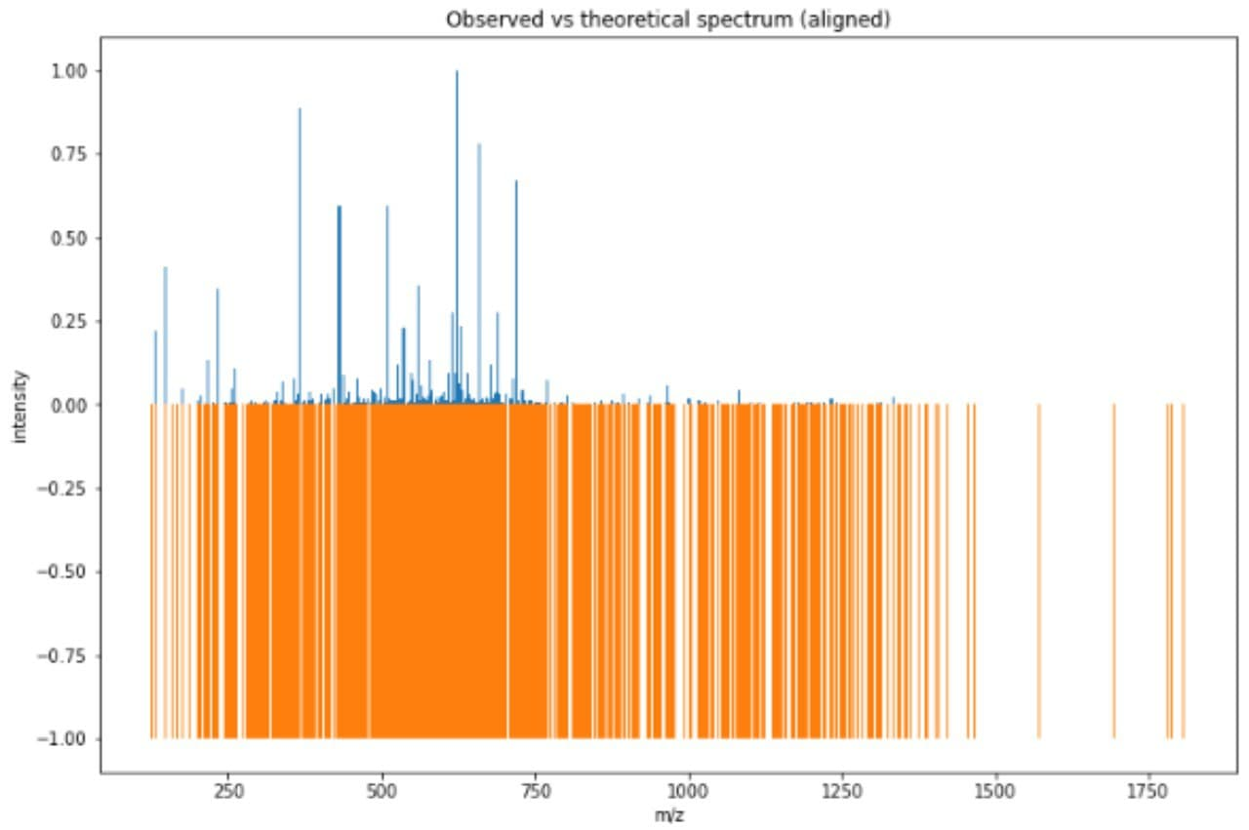

Slide 10
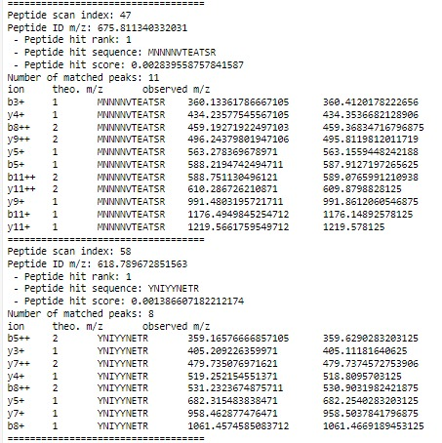
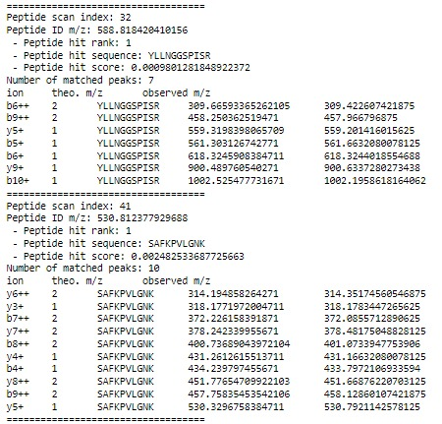
File Fusion_180220_43.mzML (Output)

Slide 11
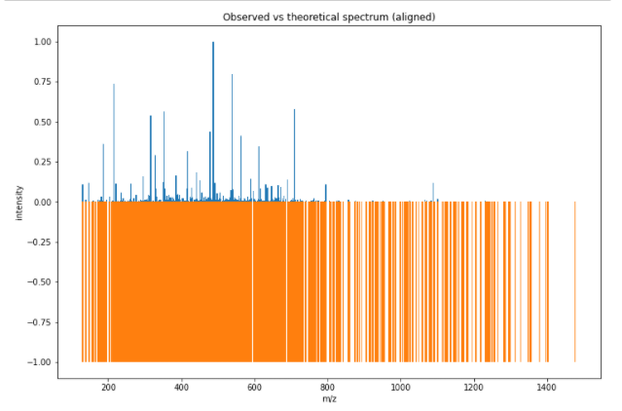

Slide 12
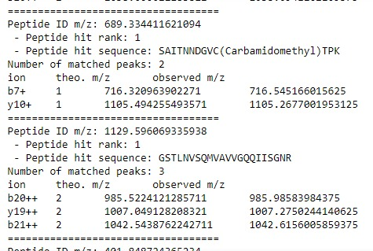
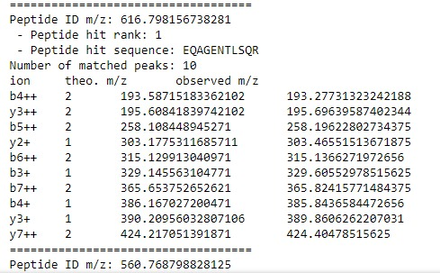
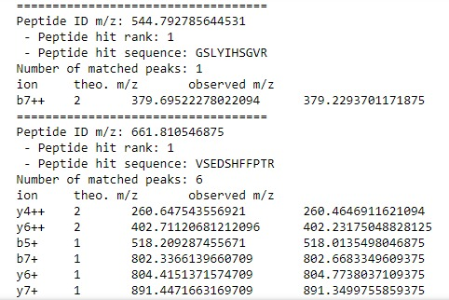
File Fusion_180220_43.mzML (Output)

Slide 13
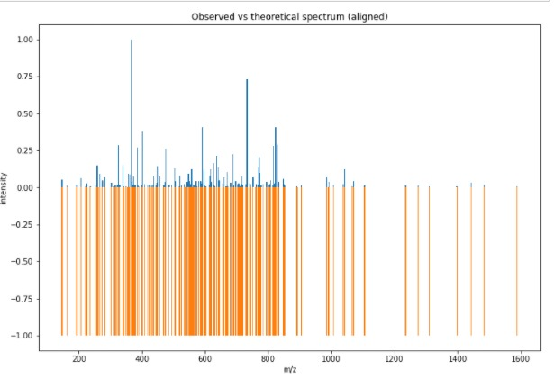

Slide 14
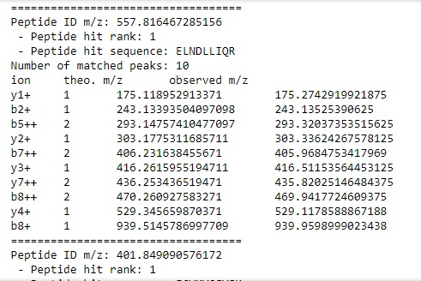
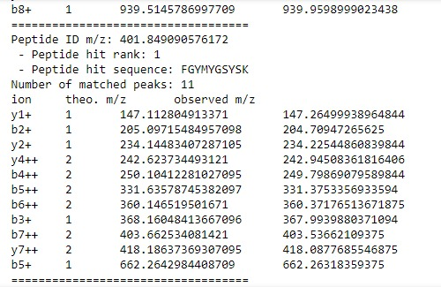
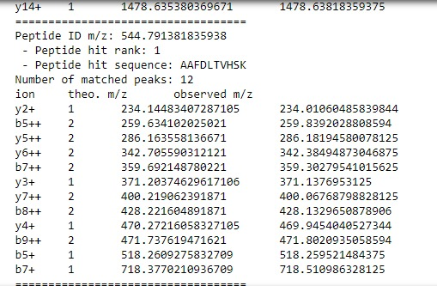
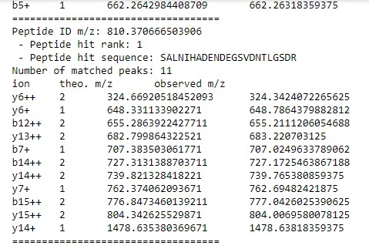
File Fusion_180220_44.mzML (Output)

Slide 15
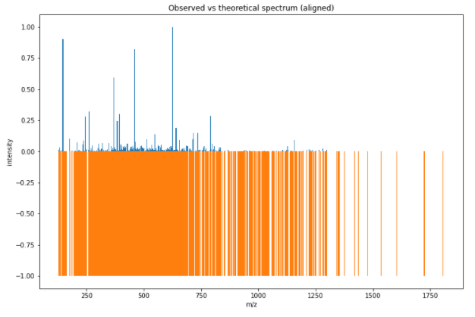

Slide 16
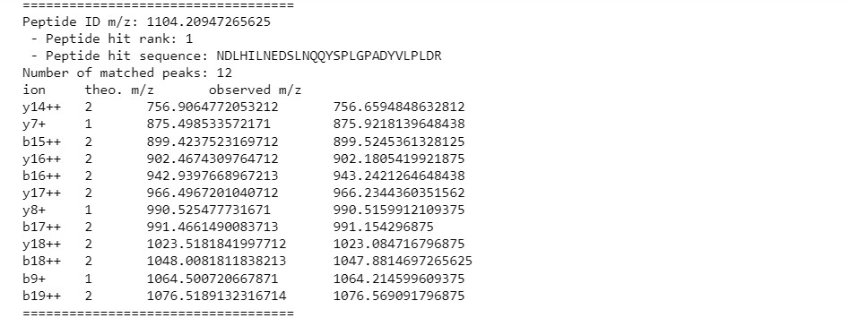
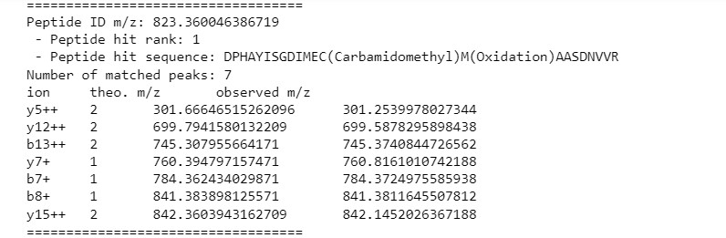
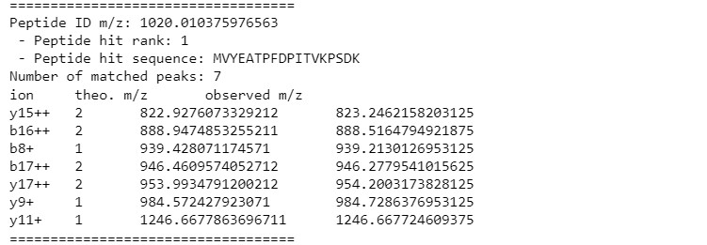
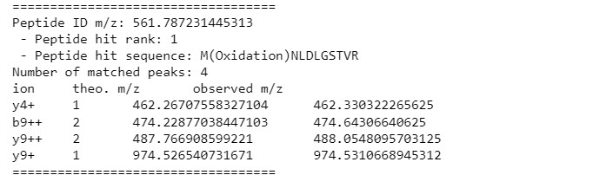
File Fusion_180220_40.mzML (Output)

Slide 17
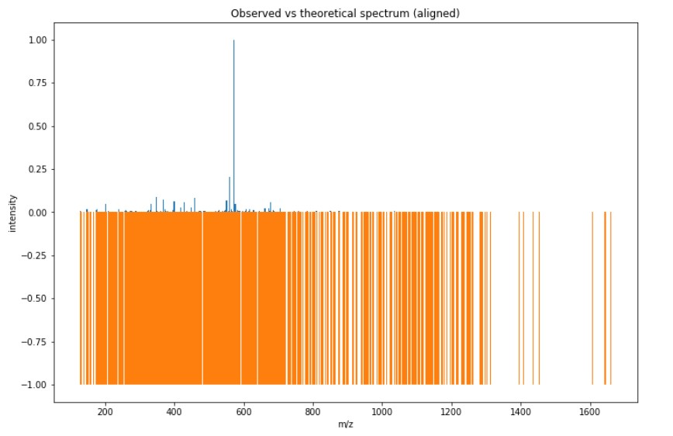

Slide 18
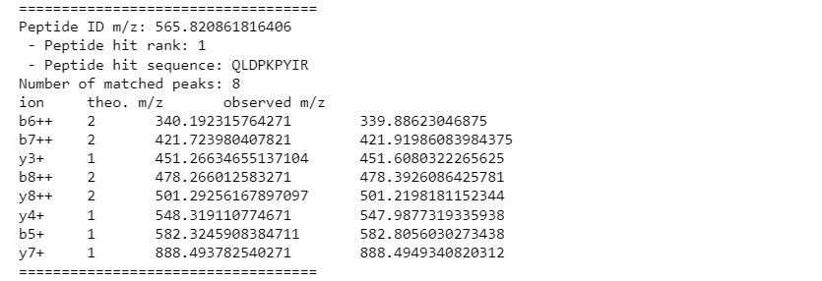
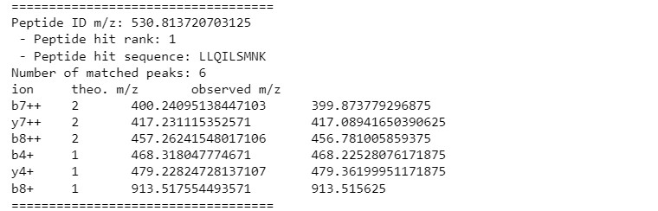
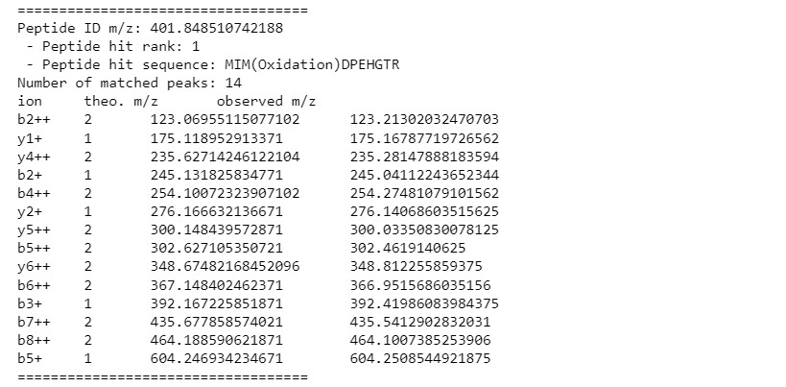
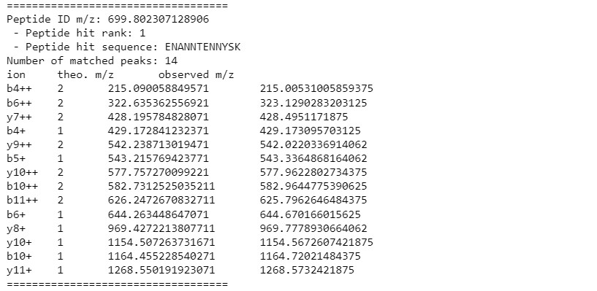
File Fusion_180220_30.mzML (Output)

Slide 19
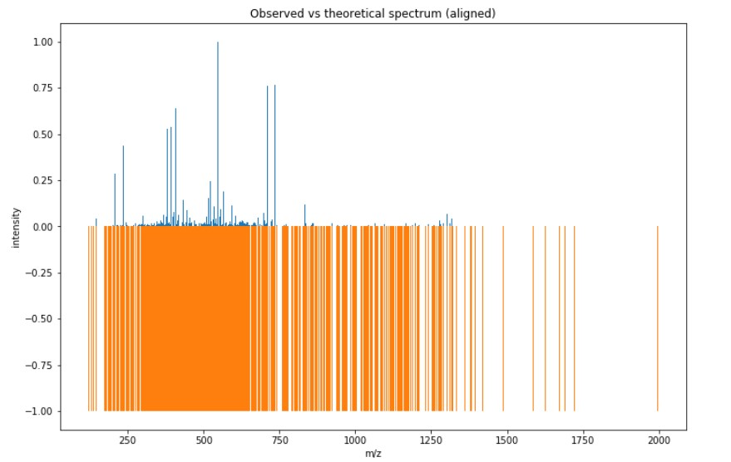

Slide 20
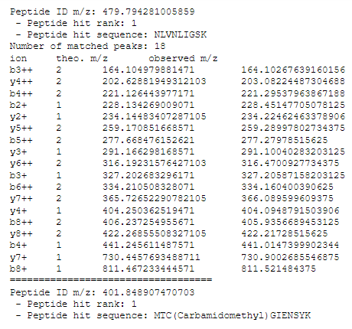
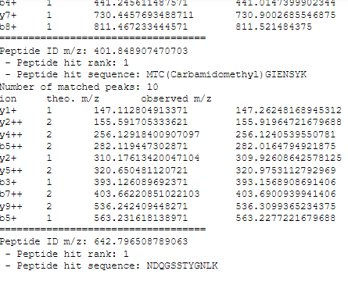
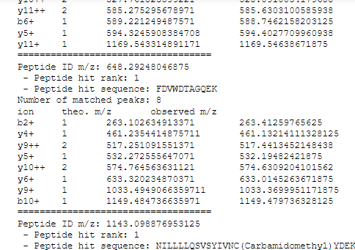
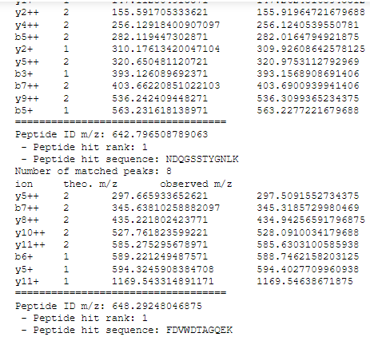
File Fusion_180220_42.mzML (Output)

Slide 21
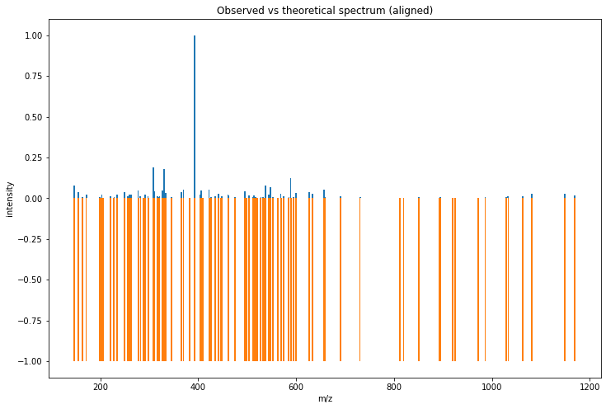

Slide 22
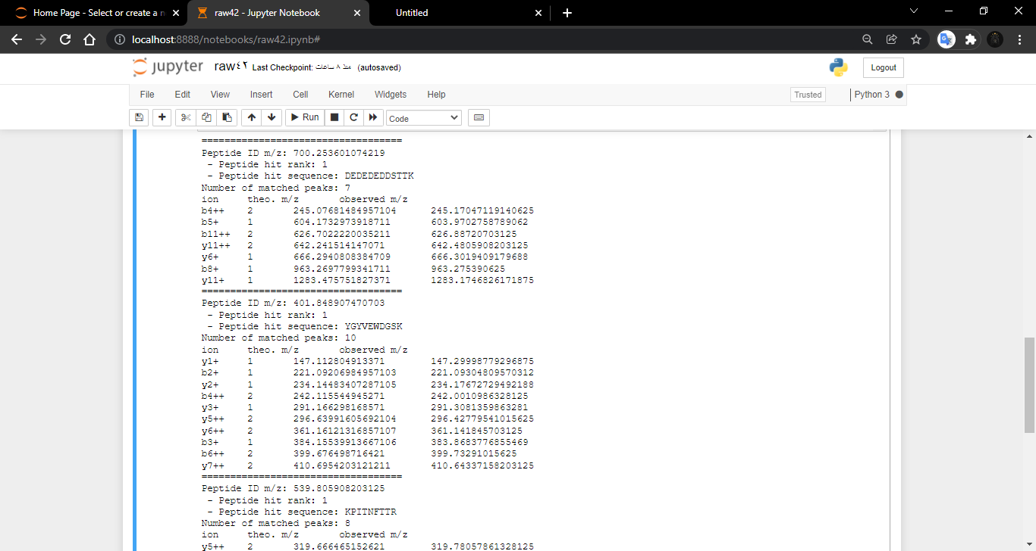
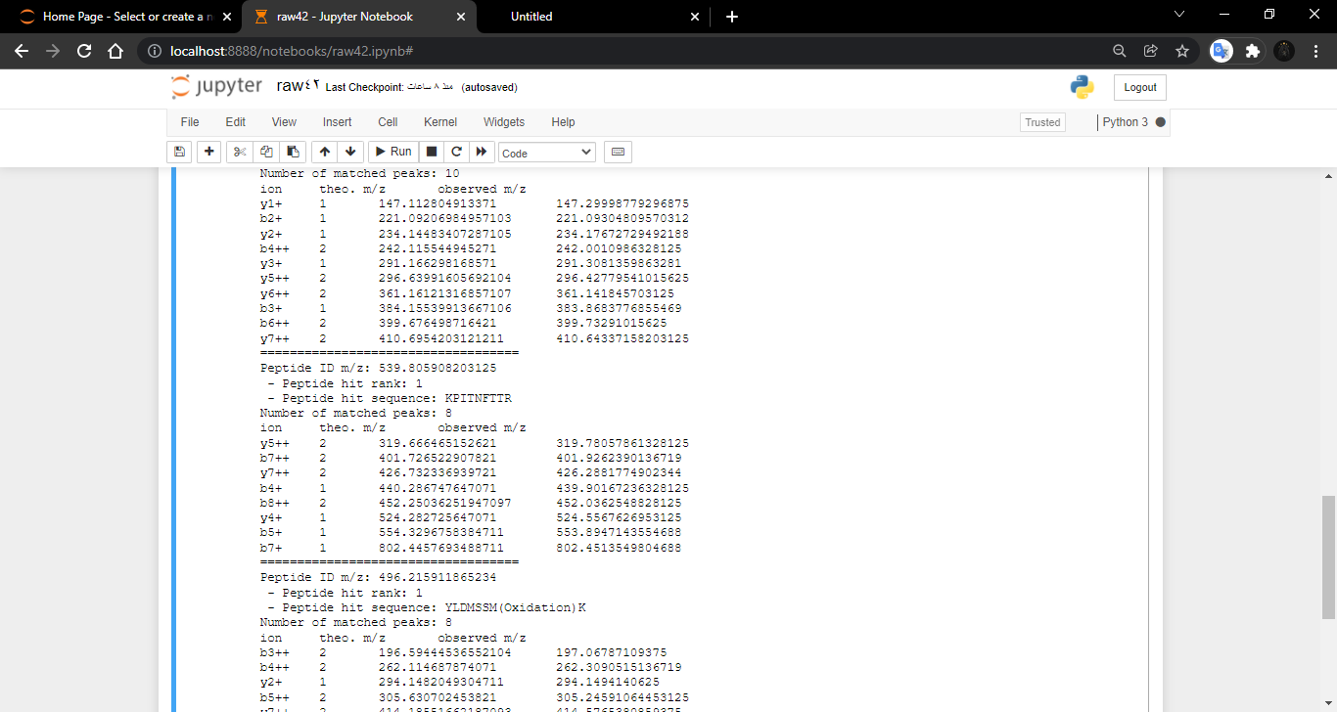
Fusion_180220_37 .mzML(Output)

Slide 23
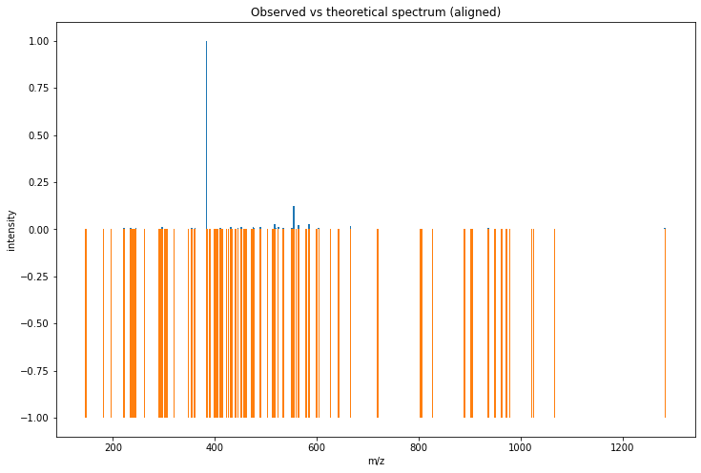

Slide 24
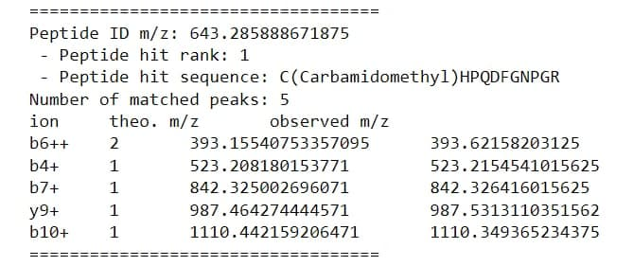
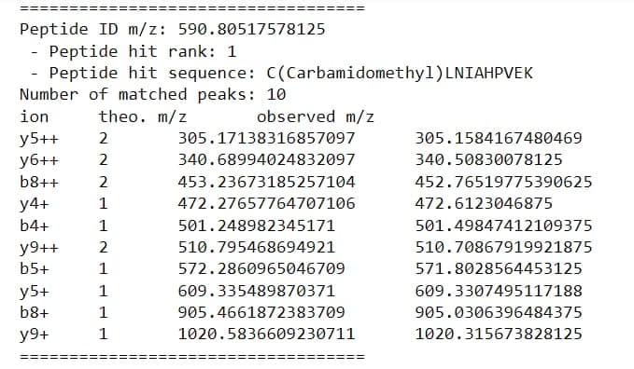
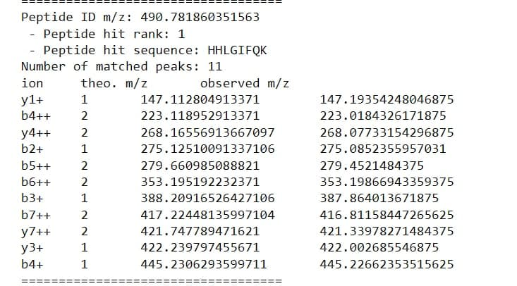
Fusion_180220_15 .mzML(Output)

Slide 25
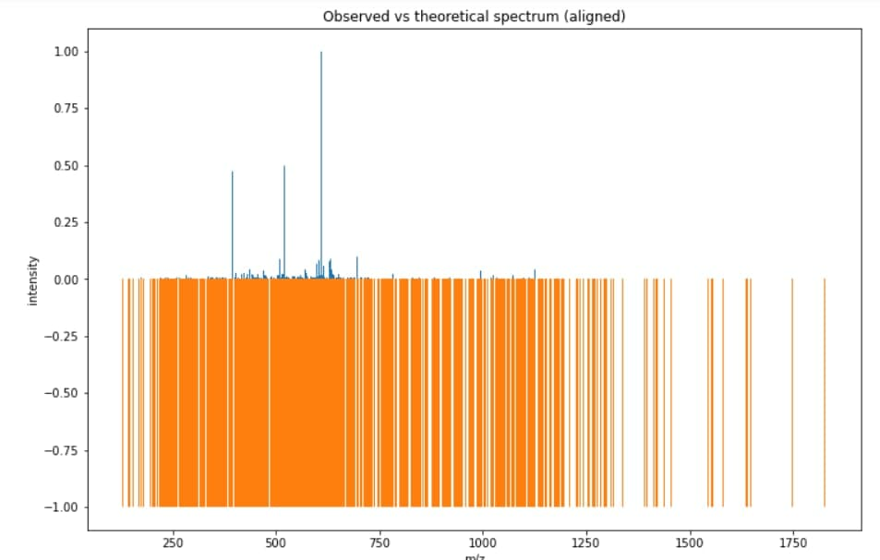

Slide 26
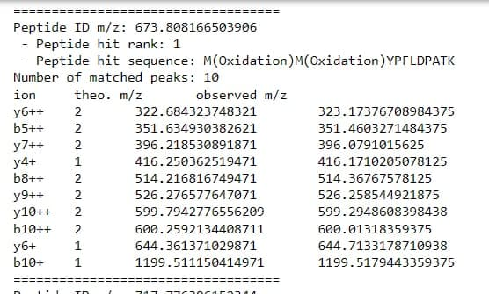
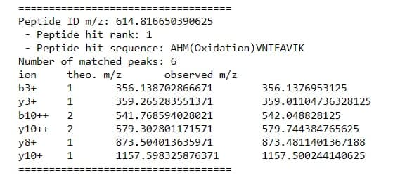
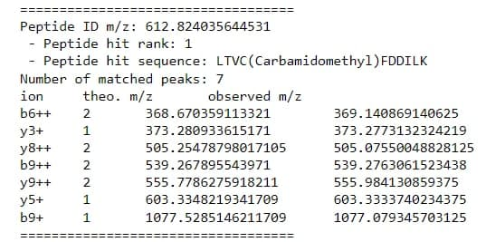
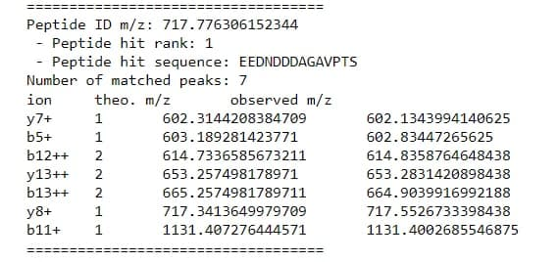
Fusion_180220_16 .mzML(Output)

Slide 27
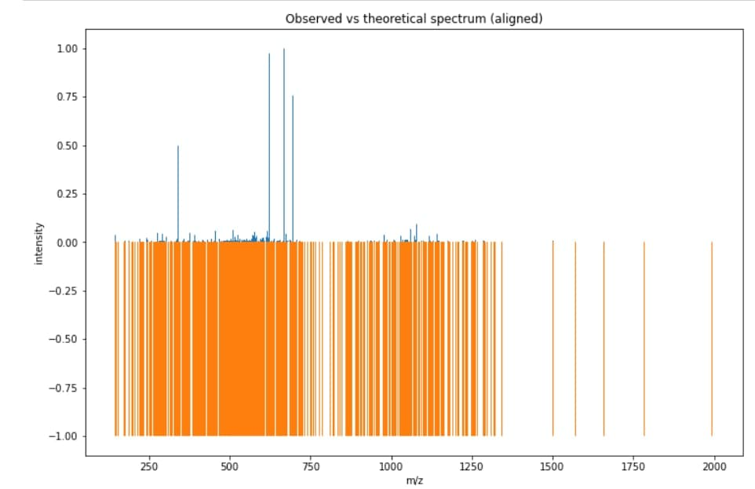

Slide 28
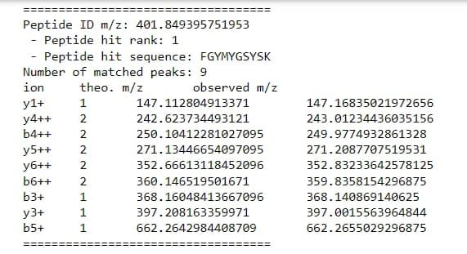


Fusion_180220_21 .mzML(Output)

Slide 29


Slide 30




Fusion_180220_22 .mzML(Output)

Slide 31


Slide 32
Thank You

